Slide 1

Observability and Monitoring with Prometheus and Grafana for Selenium Grid

Slide 2

Ioannis Papadakis
Director of QA @GWI

Slide 3


Agenda
1
Observability Theory
2
Prometheus Grafana & Selenium
3
Monitoring & Selenium Grid
4
Learnings / Q&A

Slide 4
Let’s start with some Theory

Slide 5

Notes:
Observability is the process of making a system’s internal state more transparent.
The key difference between monitoring and observability is that monitoring focuses on collecting data,
while observability focuses on understanding and interpreting that data in order to gain a deeper understanding of the system’s behavior and performance.
Observability is therefore a more proactive and holistic approach to managing complex systems,
as it enables teams to identify and address issues before they become serious problems.

Slide 6

Systems are made observable by the data they produce, which in turn helps you to determine if your infrastructure or application is healthy and functioning normally.

Slide 7
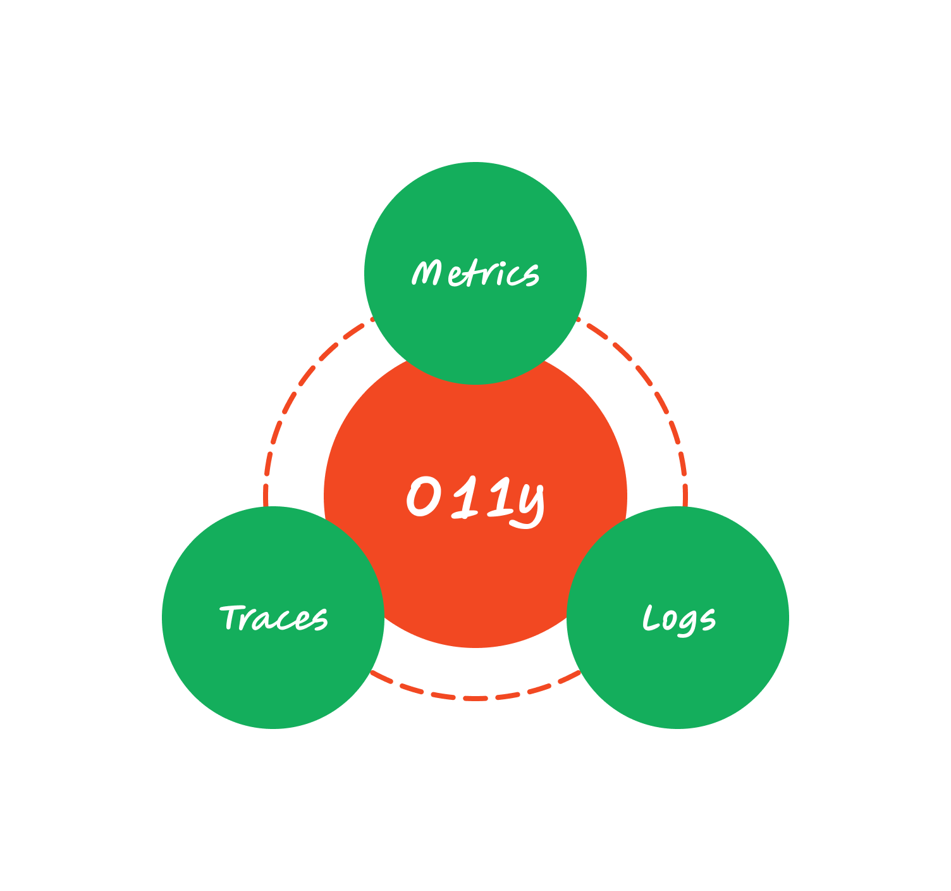
O11y is an abbreviation of observability
Notes:
If we take out the 11 letters between the O and the Y of observability, we get O11y. It is similar to Kubernetes and K8s.
Metrics will tell you about performances and checks. It represents most of the monitoring parts
Logs are per-application events that show you error messages and carry the voice of your applications
Traces are small pieces of transactions that you can group around unique business transactions. A trace is placed into multiple microservices and can be split into various pieces in the same microservice.

Slide 8
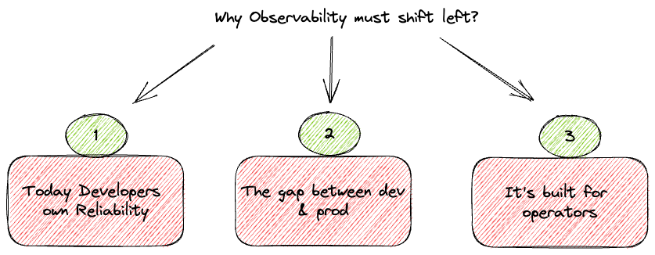
Notes:
With DevOps becoming a major part of engineering culture, developers are expected to own reliability. There is, however, a major gap in the availability of information from the running systems, as observability tools nowadays mostly focus on observing static data generated from logs and metrics instrumented by developers during development. In practice, many of the application problems that arise in a production setting are not trivial and require diving through endless dashboards to connect the dots.
With applications going fully cloud native and production environments becoming increasingly more distributed and complex, the gap between dev and prod widens significantly. This means that predicting issues ahead of time is exponentially more difficult than it was in the good ol’ days, and that reproducing these issues locally is significantly harder due to the number of pieces involved.
Existing o11y tools focus mainly on operators, not developers, and with only a fraction of the approximately 27 million developers in the world today practicing observability on a day-to-day basis, that’s becoming a real issue. For a seasoned operator, looking at the configuration of a load balancer or inspecting spikes in CPU usage is second nature — the patterns “pop up” from the screen in the same way that a badly-designed if statement or a poorly-written data structure might alert a veteran developer. Dashboards and YAML files that might indicate what is wrong with a specific deployment are often foreign to developers, leaving them in the dark when attempting to solve a production incident that involves their own code. There’s a large chasm between what they know and what they understand about it in its current, deployed state.

Slide 9

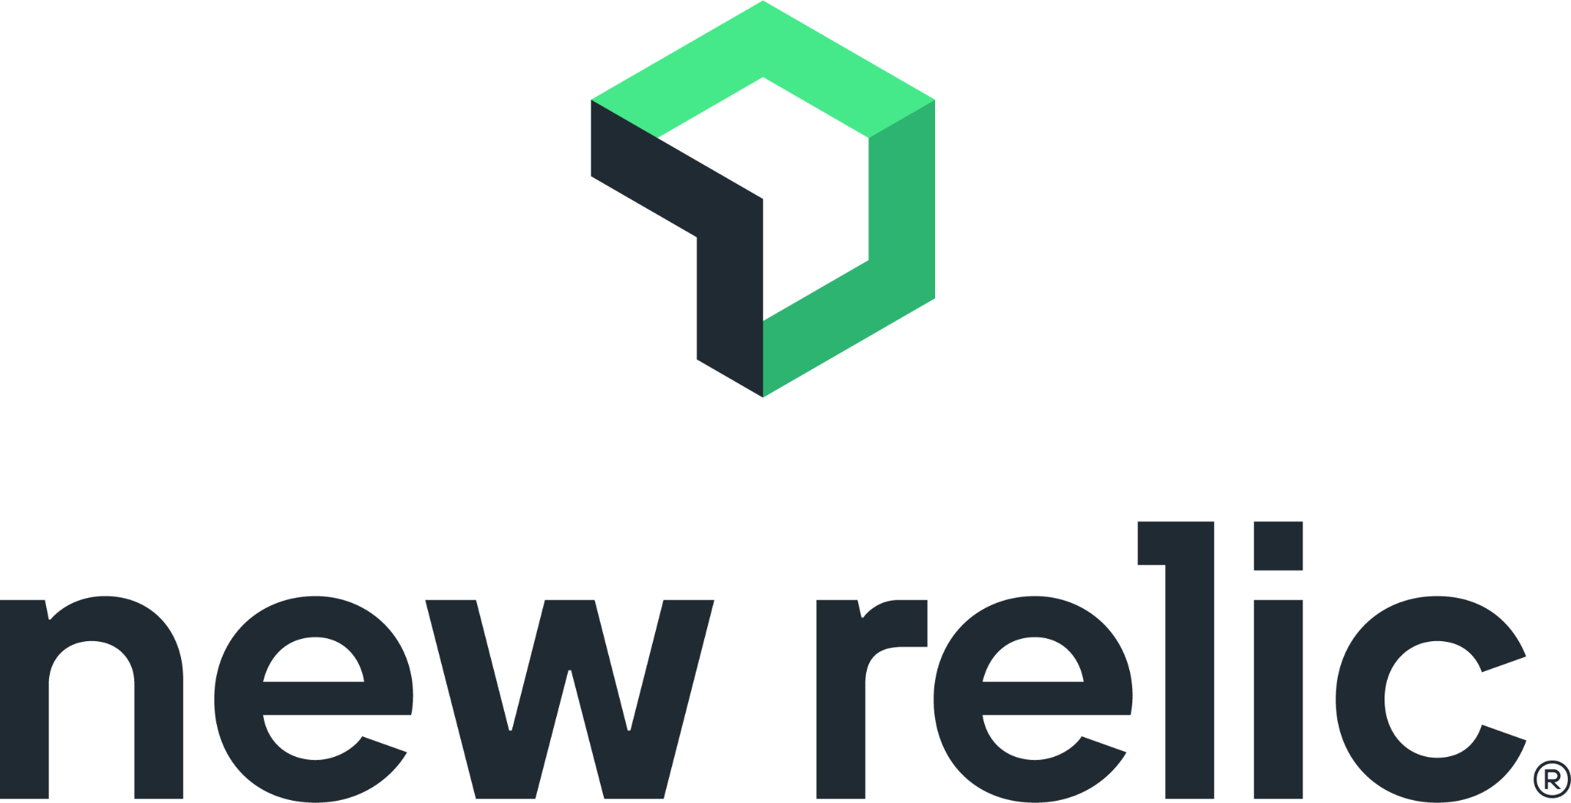







Slide 10

Prometheus is an open-source monitoring and alerting tool.
It collects data about applications and systems and allows you to visualise the data and issue alerts based on the data.
Notes:
Prometheus collects and stores its metrics as time series data. It works on the Pull Model: Prometheus server pulls metric data from exporters. Agents do not push data to the Prometheus server. Exporter is one of the basic components of the Prometheus server that exposes the data about systems and applications, which is collected by the Prometheus server. A Prometheus server gathers the metrics from different exporters and makes them available. There are a lot of exporters available e.g. Node Exporter, Apache Exporter, JSON exporters etc.

Slide 11
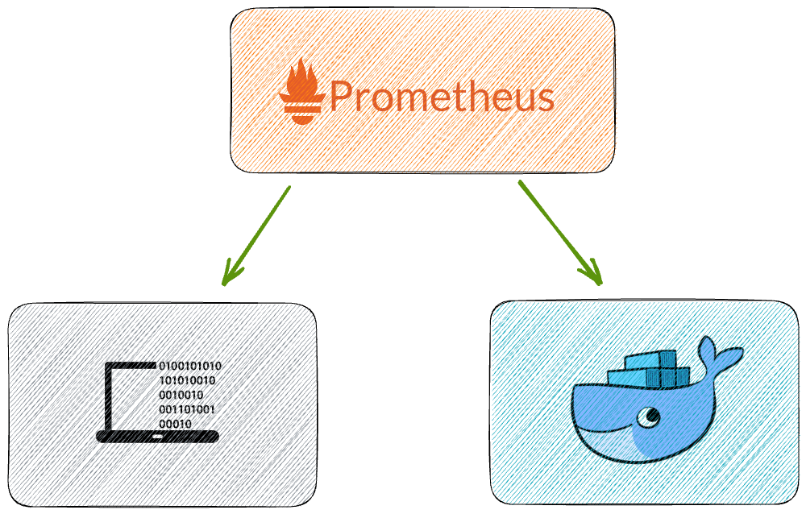
Notes:
There two ways to install prometheus locally either user binaries or use predefined docker images

Slide 12
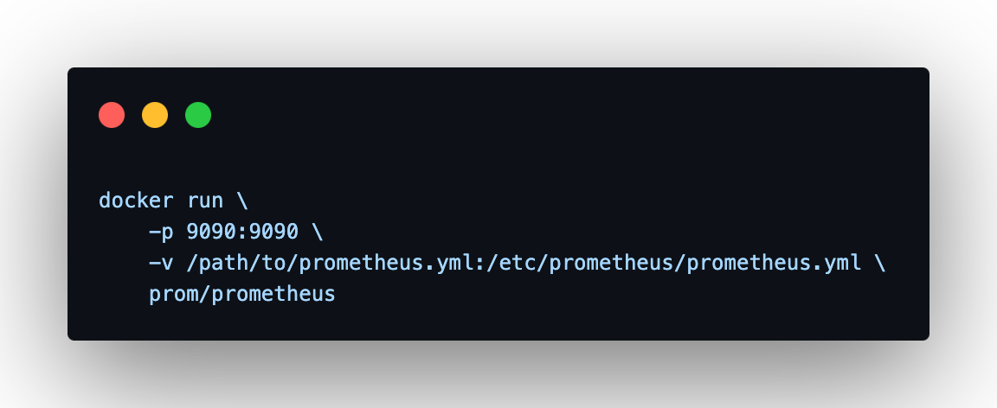


Slide 13
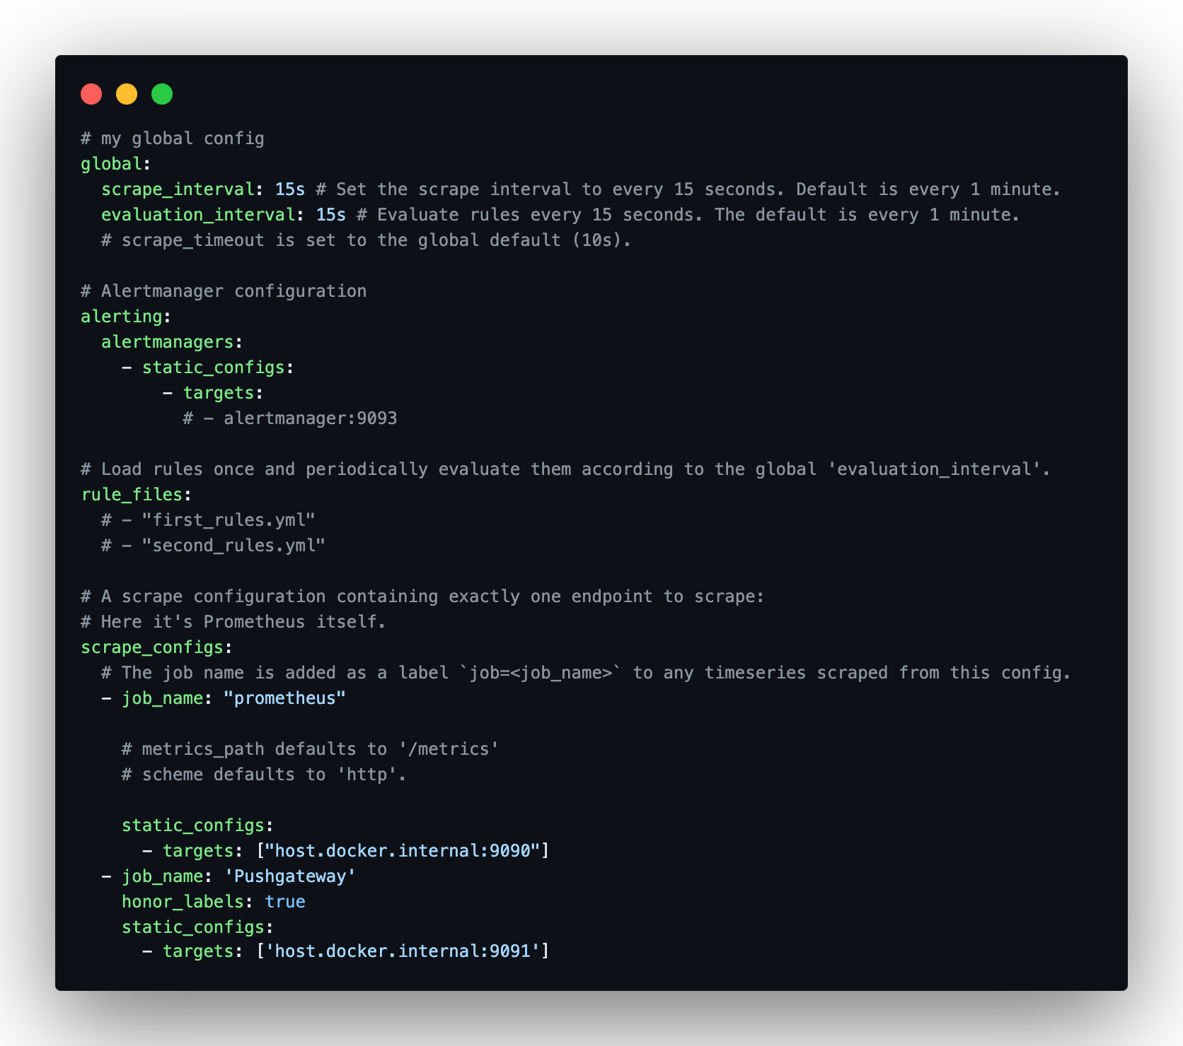
Notes:
Scrape configs add support for accessing the host for pushgateway as well that we will describe the installation separately

Slide 14

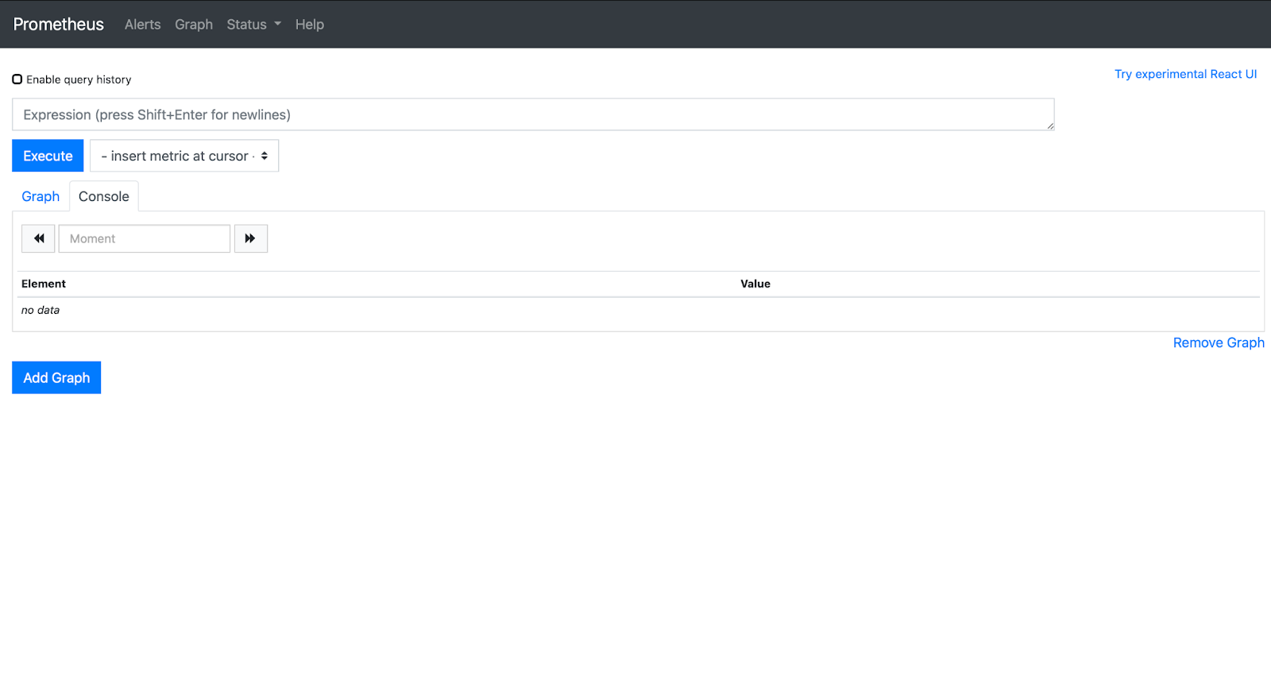

Slide 15
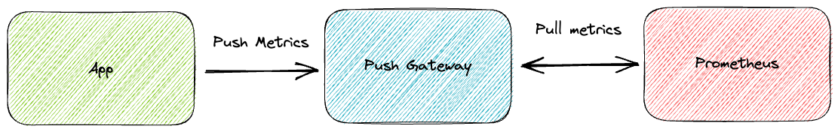
Notes:
Prometheus works on a pull model. But there are instances where jobs are not running for long or there are batch jobs that run for shorter duration, in those cases Pushgateway can be used to expose their metrics to Prometheus server.
Pushgateway never forgets. Once a stat has been added to Pushgateway it is there until explicitly deleted through the API. This means that Prometheus will scrape that stat even if it is no longer required or relevant e.g. that login Lambda has been retired for a Kube micro service the lambda stats will still be on the pushgateway.
If the service sending to Pushgateway is down the stats on Pushgateway will still be scraped. With a normal Prometheus metrics page if the service is down often the metrics page will also be down which means that Prometheus won’t gather any stats and can also report that the service is unreachable. Using Pushgateway, Prometheus will carry on scrapping the stats without any knowledge that they are totally wrong leading to misleading and incorrect data.
A Pushgateway server can only be setup once in the Prometheus configuration so all jobs sent to that Pushgateway will be scraped with the same intervals and settings. To get round this you could setup multiple Pushgateways depending on the require scrape config.
The timestamp used by the Prometheus ingestion will be the timestamp when Prometheus scrapes rather than the time the metric was pushed to the Gateway. This seems odd at first, but if it used the timestamp of the push then Prometheus would be scraping the same metric with the same timestamp over and over until it was updated which would be inconsistent with how Prometheus scrapes exporters.

Slide 16
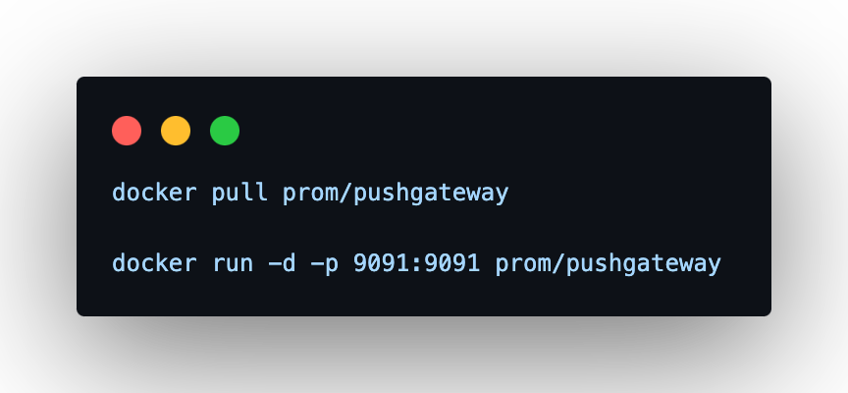
Once is established you need to configure Prometheus to scrape metrics from PushGateway
Notes:
The Pushgateway is a really handy service to complete your Prometheus monitoring where you don’t want to or can’t run an exporter for a service. It is easy to use and built into the Prometheus clients. So long as you are aware of the gotchas and guard around them then it can really fill the gaps in your coverage.

Slide 17
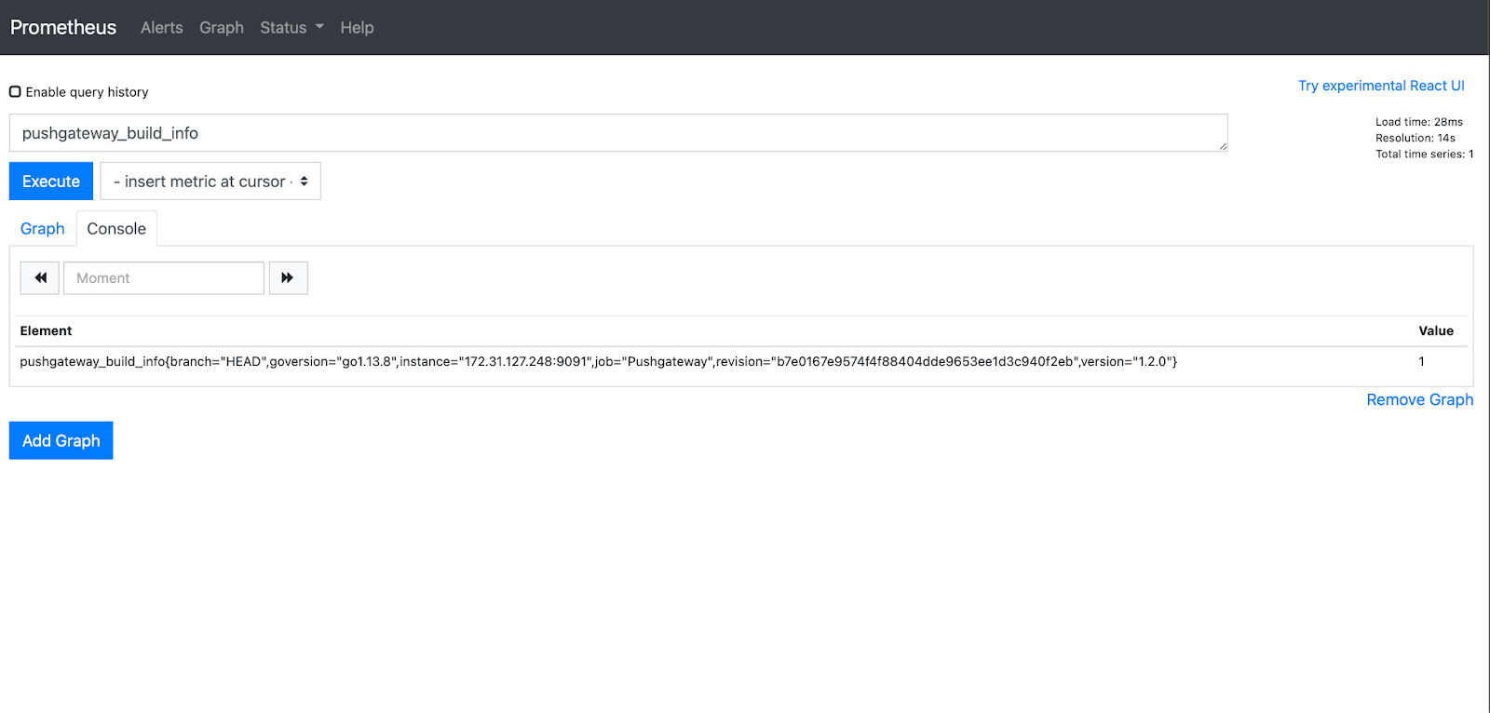
If you deployed Push Gateway successfully you should be able to execute following query

Slide 18
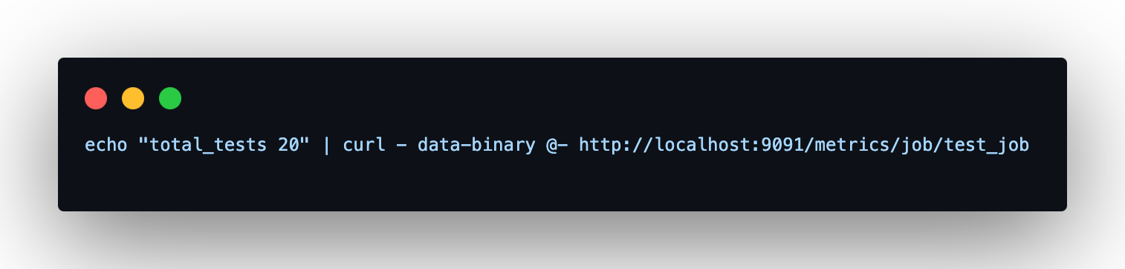
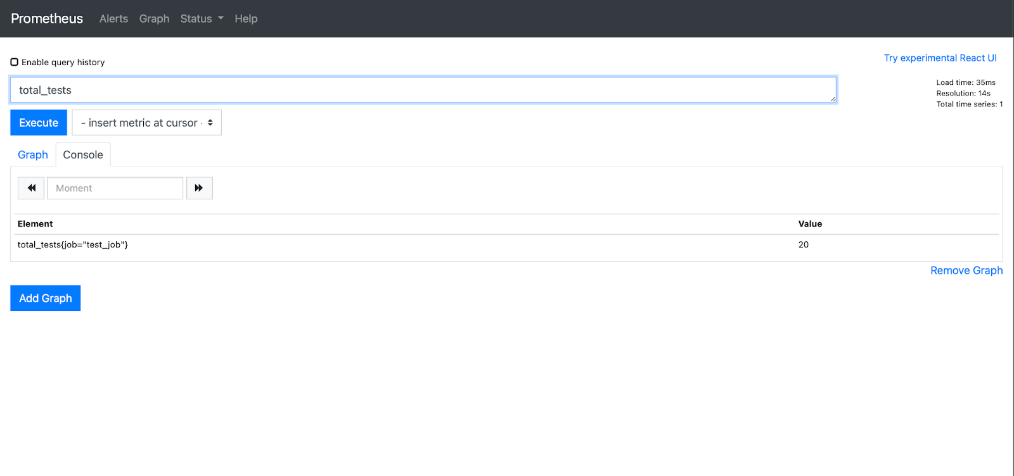
Pushing metrics to Push Gateway with curl

Slide 19
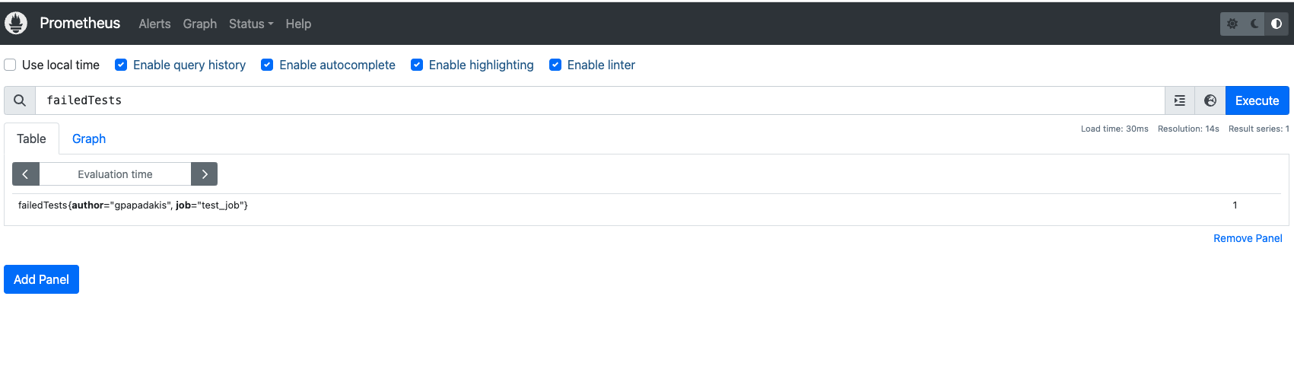
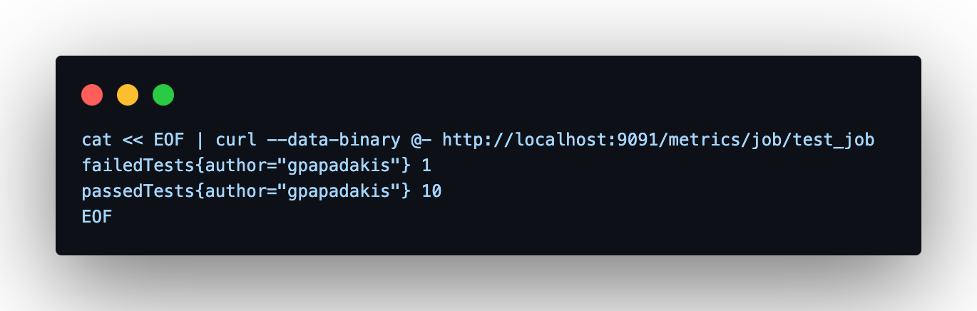
Push multiple metrics with predefined labels

Slide 20

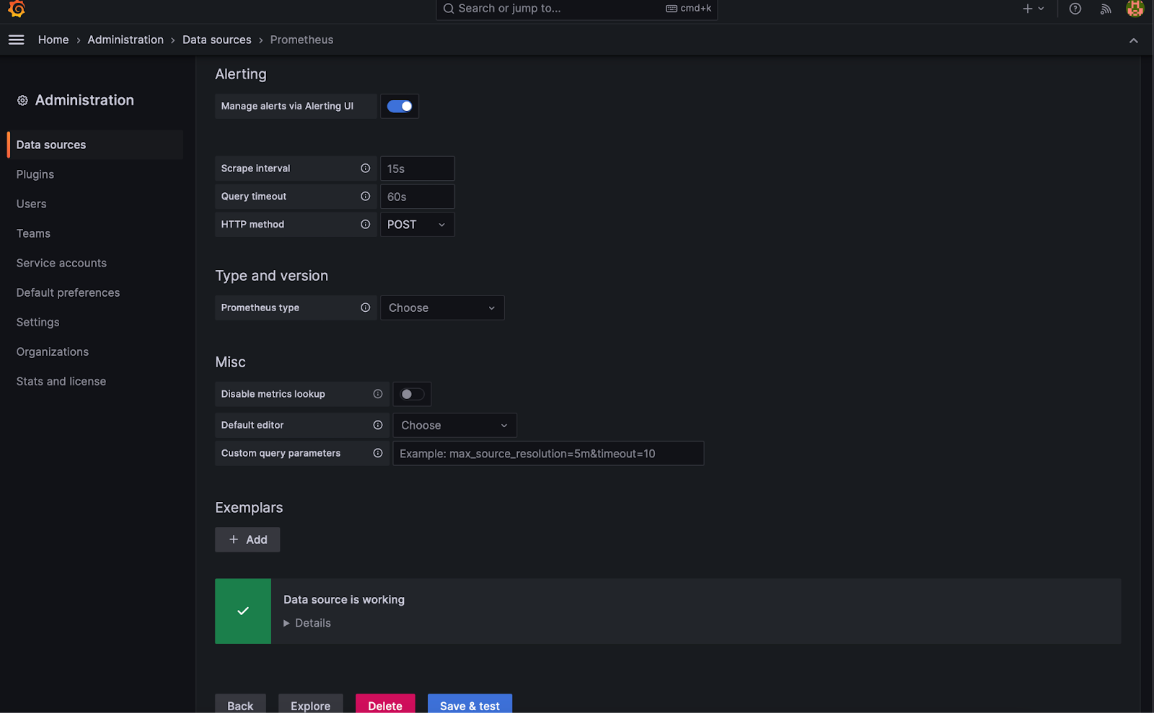
Installing Grafana and setting up Prometheus as datasource to visualise metrics in dashboards

Slide 21
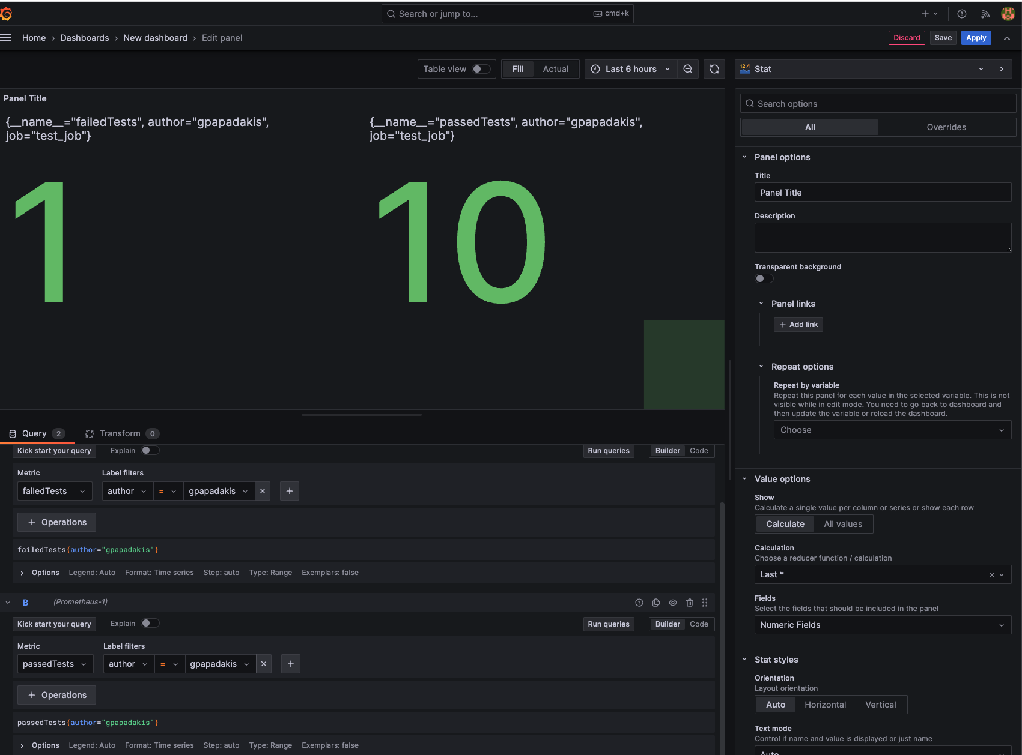
Establish queries to visualise metrics scraped from Push Gateway

Slide 22


Slide 23

Selenium & Observability

Slide 24


There are two observability patterns when it comes to Selenium
Observe Selenium Grid usage and uptime
Observe E2E test suites and keep historical data for your executions
In this presentation and demo we will go through each one of them in detail!

Slide 25

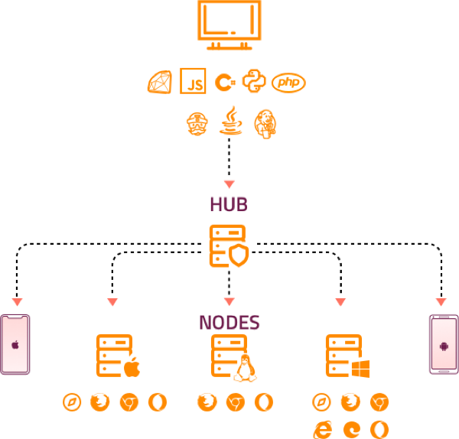
Notes:
Prometheus Alert Manager used to alert to slack any potential downtime of the Selenium Grid
Most of the metrics that can be exported to Prometheus can be shown in the next slide

Slide 26
Metrics
Selenium_grid_max_session (maximum number of sessions)
Selenium_grid_node_count (number of nodes)
Selenium_grid_session_count (number of active sessions)
selenium_grid_session_queue_size (number of queued sessions)
selenium_node_max_session maximum (number of sessions on node)
selenium_node_session_count (number of active sessions on node)

Slide 27
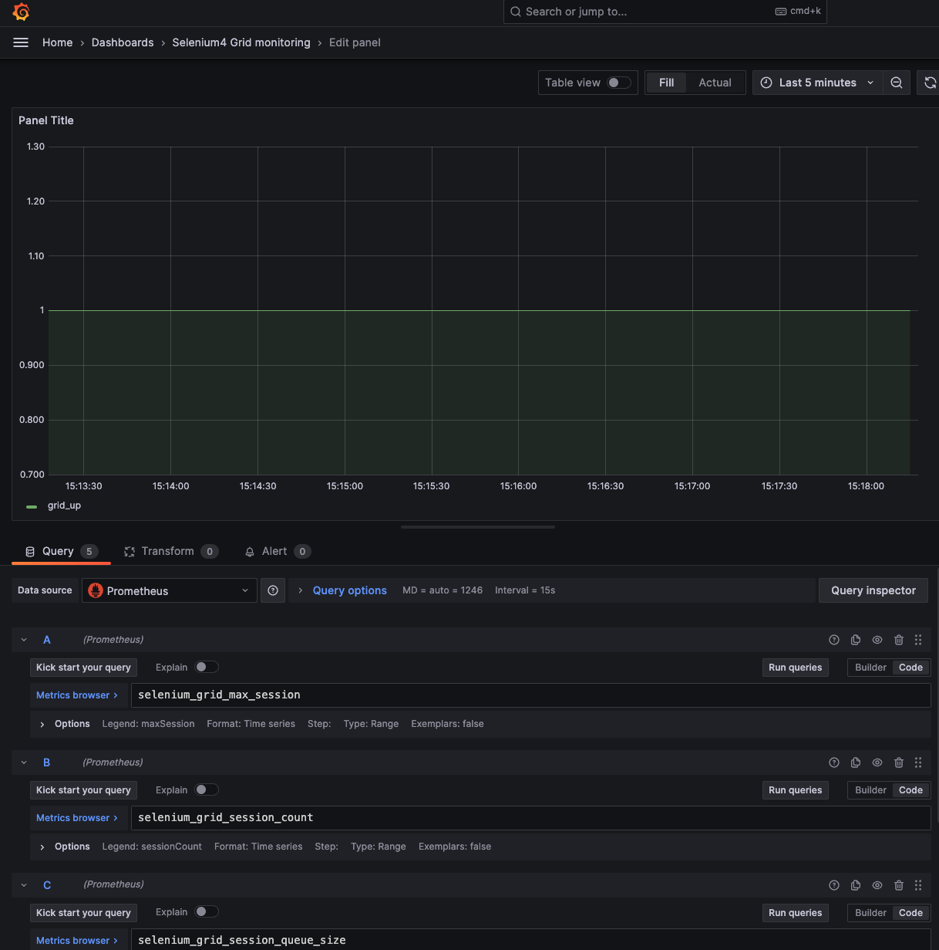
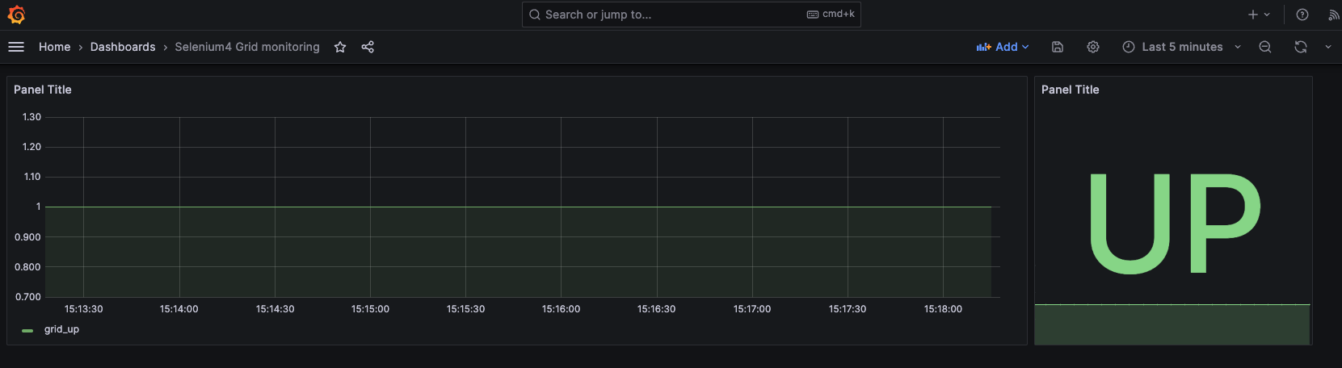
Metrics Query
UpTime

Slide 28
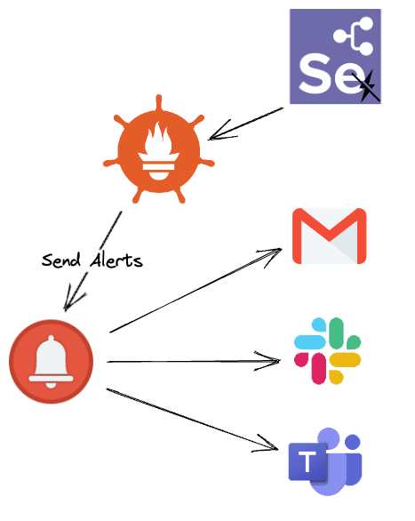
You need to implement alerting strategy for issues may affect uptime of Selenium Grid

Slide 29
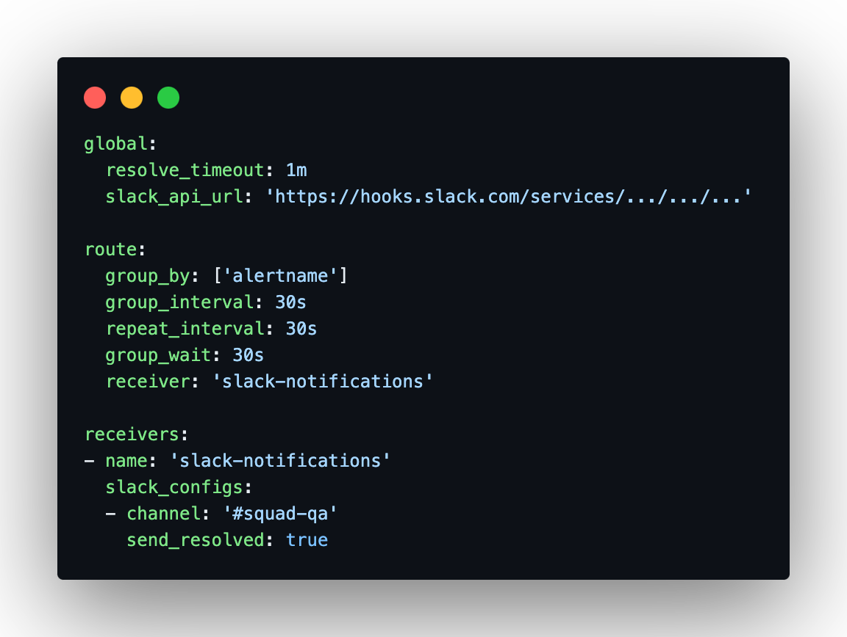
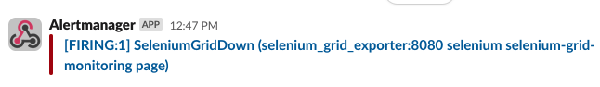
Setting up alerts to inform teams for any Selenium Grid outage.
Set up AlertManager with Prometheus and Slack in few minutes!

Slide 31

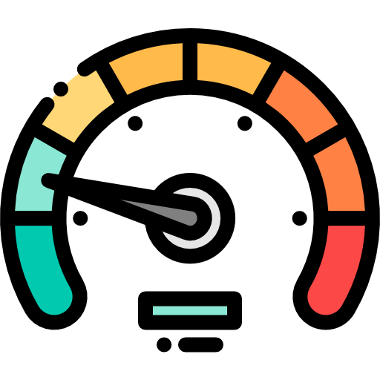
E2E level is really slow imagine suite taking 1 - 2 hours to finish execution how can we proactively monitor real time?

Slide 32
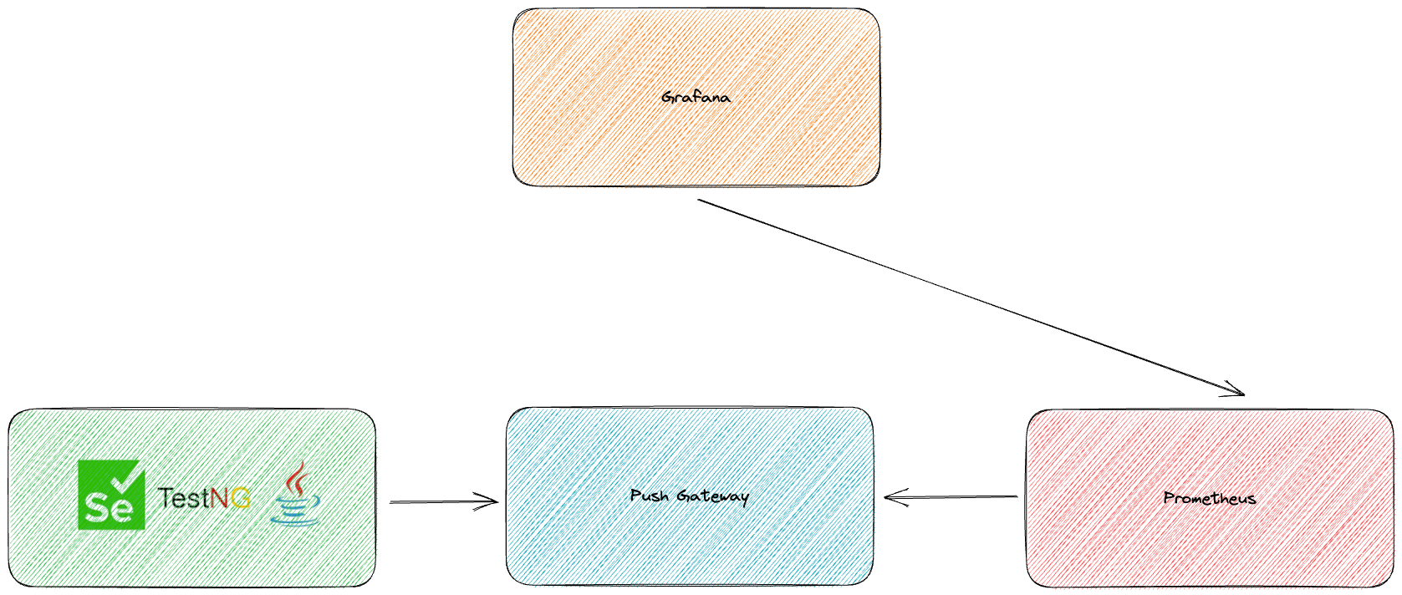

Slide 33
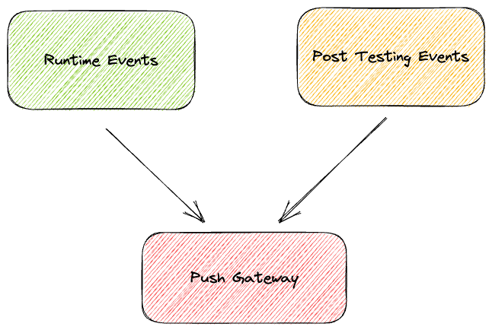

Slide 34
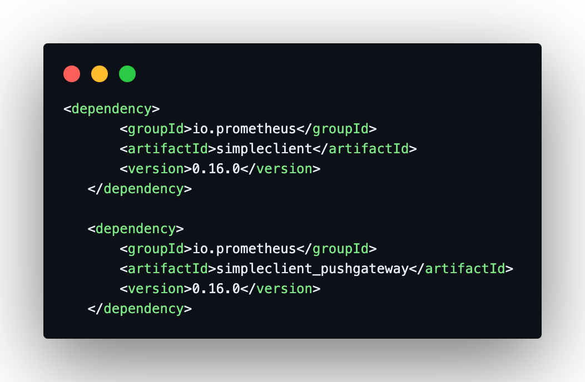
Add Prometheus and Push Gateway Java Clients in your Maven Project

Slide 35

And how can we aggregate runtime results?

Slide 36
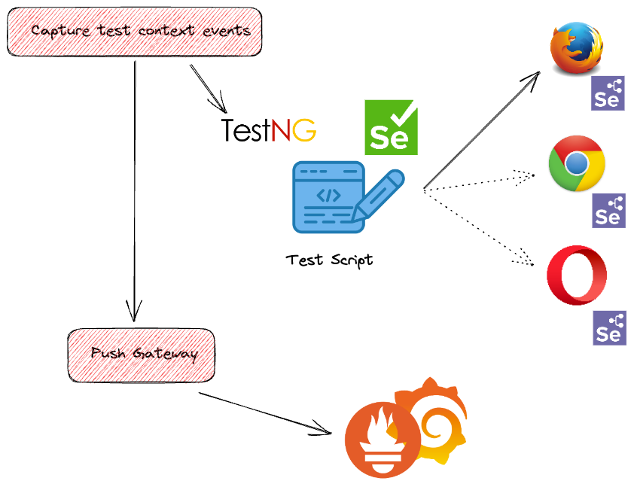

Slide 37
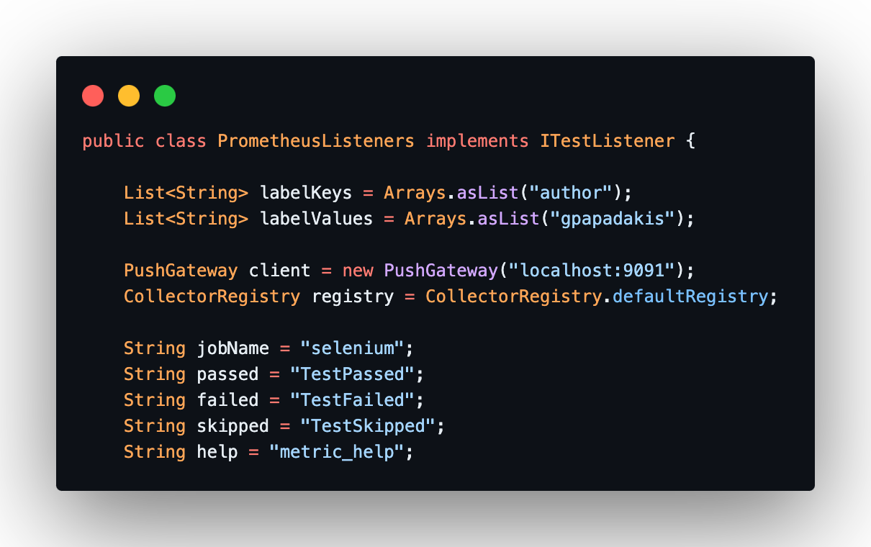
Setup you listener providing information for metrics:
Labels
Job Name
Metrics Name
Help

Slide 38
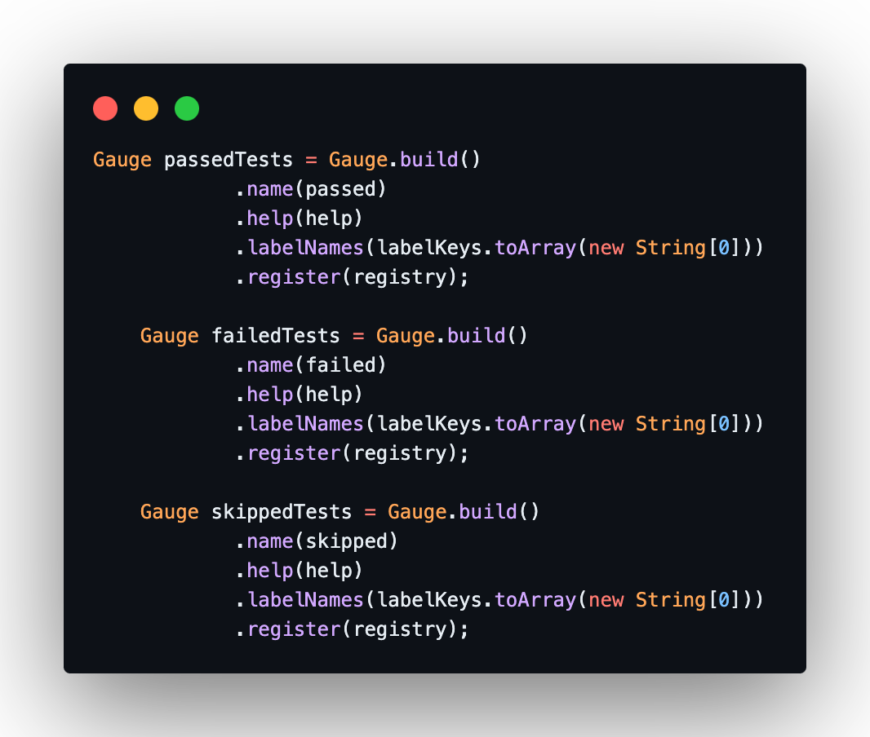
A gauge is a metric that represents a single numerical value that can arbitrarily go up and down.
Differentiate based on state
Notes:
Gauges are typically used for measured values like temperatures or current memory usage, but also "counts" that can go up and down, like the number of concurrent requests.

Slide 39
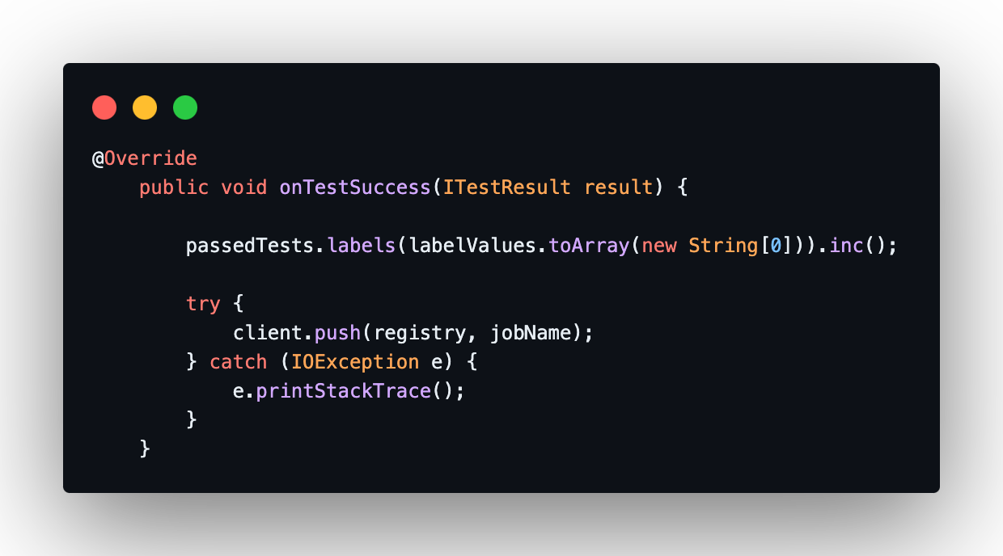
Always increment gauge metric to get a summary in Prometheus

Slide 41
Learnings
Observability must shift left
Observe Selenium Grid 4 Uptime & Usage
Observe E2E test suites in historical manner
Observability needs to be cultivated within dev teams

Slide 42



Get involved
Selenium: selenium.dev / github.com/SeleniumHQ
Selenium documentation: Selenium docs
seleniumhq.slack.com
SeleniumHQ/selenium

